Slide 1
Lab 1: Intro to Big Data principles
Rangarajan Vasudevan
Founder, TheDataTeam
CS4830
Feb 2022

Slide 2





About me
Cadenz.ai is the market’s first Customer Intelligence Platform that provides enterprises live behaviour intelligence about its customers using its data automatically.
TheDataTeam is a premier provider of customer intelligence solutions using advanced ML and the power of cloud.
Established: 2015
Offices: Singapore, Philippines, India

Slide 3

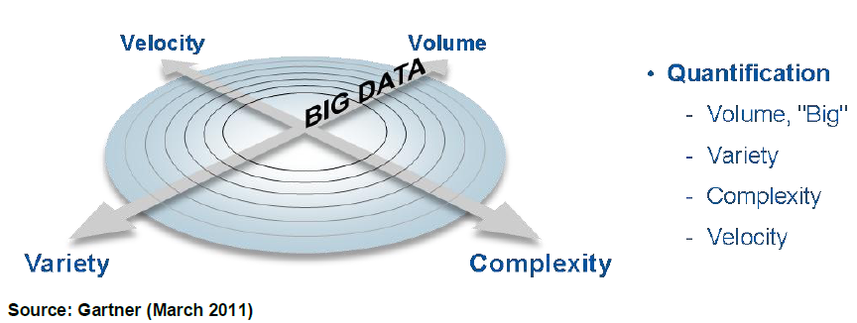
BIG DATA IS NOT THE
THREE V’S

Slide 4
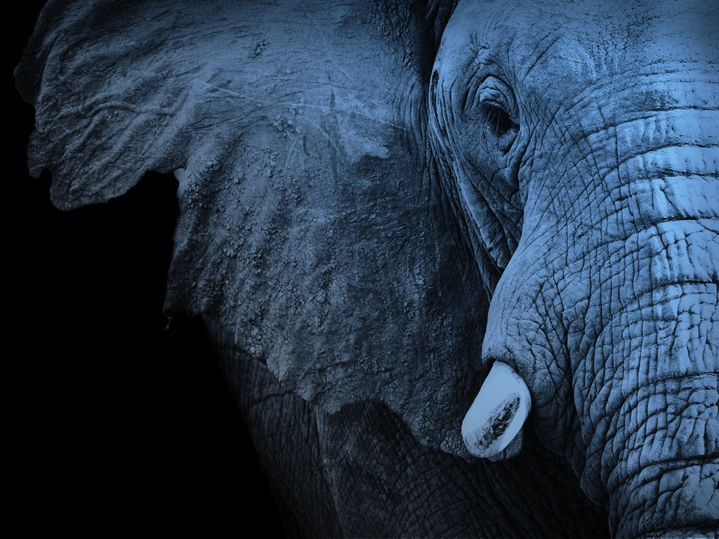
BIG DATA IS NOT A
TECHNOLOGY
Notes:
It is not a technology, many organizations say that Big Data is Equal to Hadoop. They might say this because Hadoop can easily injest large volumes of data but that is only a piece of the story

Slide 5
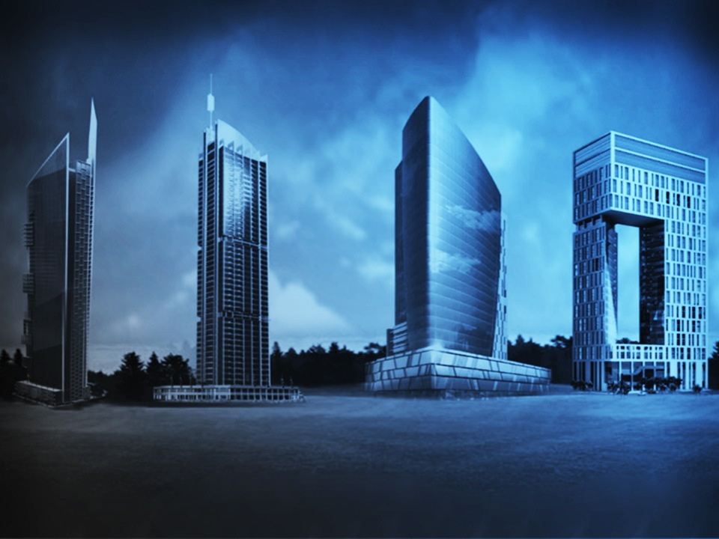
BIG DATA IS NOT AN
ARCHITECTURE

Slide 6

ALL data
ANY time
ANY method

Slide 7
Why bother with Data?
Actions
ACTIVATING MAKE it happen!
OPERATIONALIZING
WHAT IS
happening now?
Insights
PREDICTING
WHAT WILL happen?
Automated Linkages
ANALYZING
WHY did it happen?
Link to Operational Systems
REPORTING
WHAT happened?
Predictive Models
Ad Hoc, BI Tools
Batch Reports
Does this process change with Big Data? No.
Do the tools you need change? Yes.

Slide 8
Big Data in the era of Cloud
Compute decoupled from storage
Independently planned, separately executed
Needs a way to know where is what data spread across
Compute is scaled across all available resources, so parallelism is key
Maximum flexibility in:
Types of compute
Type of storage

Slide 9
Big Data – Key Concepts
Divide-and-conquer – planning, scheduling, execution
Duality of hashing vs sorting

Slide 10
MapReduce
Map Function
Prime example of Divide-and-Conquer
A parallel programming framework
Any programming language
Harness 100s to 1000s of CPUs
Optimizes for massive scale to avoid using too much memory
MapReduce provides
Automatic parallelization
Fault tolerance
Monitoring & status updates
Scheduler
map
shuffle
reduce
Results

Slide 11
Spark
A parallel programming framework
Scala, Java, Python (primary interfaces)
Harness 100s to 1000s of CPUs
Optimizes for memory in order to get speed
Spark also provides
Automatic parallelization
Fault tolerance
Monitoring & status updates
Another example of Divide-and-Conquer

Slide 12
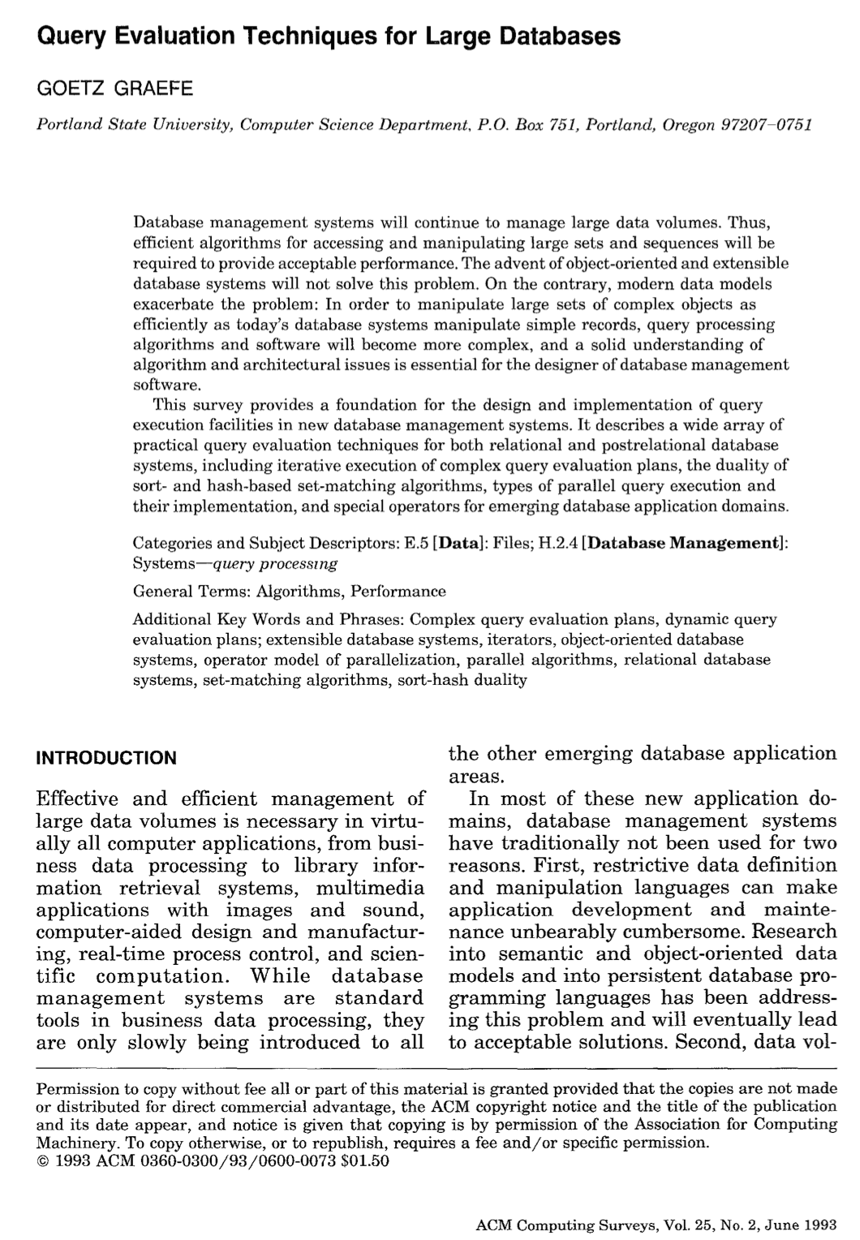
Duality of Sorting & Hashing
Sorting == Hashing
Sort algorithms
Small scale - quicksort
Large scale – mergesort with spill to disk
Hash algorithms
Small scale – hash table
Large scale – partitioned hash table etc.

Slide 13
Sorting
10-Jan | 11:10 | 1001
10-Jan | 9:45 | 1002
10-Jan | 11:30 | 1003
10-Jan | 6:02 | 1004
10-Jan | 8:09 | 1005
10-Jan | 12:00 | 1006
10-Jan | 6:02 | 1004
10-Jan | 8:09 | 1005
10-Jan | 9:45 | 1002
10-Jan | 11:10 | 1001
10-Jan | 11:30 | 1003
10-Jan | 12:00 | 1006
1-6 | 0
6-12 | 6
12-18 | 0
18-24 | 0
1-6 | 0
1-6 | 0
1-6 | 2
1-6 | 2
1-6 | 0
1-6 | 4
Date | Time | UserID
10-Jan | 11:10 | 1001
10-Jan | 9:45 | 1002
10-Jan | 11:30 | 1003
10-Jan | 6:02 | 1004
10-Jan | 8:09 | 1005
10-Jan | 12:00 | 1006
10-Jan | 13:06 | 1007
10-Jan | 13:04 | 1008
10-Jan | 13:01 | 1009
10-Jan | 12:59 | 1010
10-Jan | 6:34 | 1011
10-Jan | 6:48 | 1012
10-Jan | 2:11 | 1013
10-Jan | 5:33 | 1014
10-Jan | 16:26 | 1015
10-Jan | 16:23 | 1016
10-Jan | 19:20 | 1017
10-Jan | 16:34 | 1018
10-Jan | 18:34 | 1019
10-Jan | 18:23 | 1020
10-Jan | 16:56 | 1021
10-Jan | 3:45 | 1022
10-Jan | 5:34 | 1023
10-Jan | 17:32 | 1024
10-Jan | 19:22 | 1025
10-Jan | 23:54 | 1026
10-Jan | 23:52 | 1027
10-Jan | 13:45 | 1028
10-Jan | 13:23 | 1029
10-Jan | 12:23 | 1030
10-Jan | 13:06 | 1007
10-Jan | 13:04 | 1008
10-Jan | 13:01 | 1009
10-Jan | 12:59 | 1010
10-Jan | 6:34 | 1011
10-Jan | 6:48 | 1012
10-Jan | 6:34 | 1011
10-Jan | 6:48 | 1012
10-Jan | 12:59 | 1010
10-Jan | 13:01 | 1009
10-Jan | 13:04 | 1008
10-Jan | 13:06 | 1007
1-6 | 0
6-12 | 2
12-18 | 4
18-24 | 0
6-12 | 6
6-12 | 2
6-12 | 0
6-12 | 0
6-12 | 0
6-12 | 8
10-Jan | 2:11 | 1013
10-Jan | 5:33 | 1014
10-Jan | 16:26 | 1015
10-Jan | 16:23 | 1016
10-Jan | 19:20 | 1017
10-Jan | 16:34 | 1018
10-Jan | 2:11 | 1013
10-Jan | 5:33 | 1014
10-Jan | 16:23 | 1016
10-Jan | 16:26 | 1015
10-Jan | 16:34 | 1018
10-Jan | 19:20 | 1017
1-6 | 2
6-12 | 0
12-18 | 3
18-24 | 1
12-18 | 0
12-18 | 4
12-18 | 3
12-18 | 2
12-18 | 3
12-18 | 12
10-Jan | 18:34 | 1019
10-Jan | 18:23 | 1020
10-Jan | 16:56 | 1021
10-Jan | 3:45 | 1022
10-Jan | 5:34 | 1023
10-Jan | 17:32 | 1024
10-Jan | 3:45 | 1022
10-Jan | 5:34 | 1023
10-Jan | 16:56 | 1021
10-Jan | 17:32 | 1024
10-Jan | 18:23 | 1020
10-Jan | 18:34 | 1019
1-6 | 2
6-12 | 0
12-18 | 2
18-24 | 2
18-24 | 0
18-24 | 0
18-24 | 1
18-24 | 2
18-24 | 3
18-24 | 6
10-Jan | 19:22 | 1025
10-Jan | 23:54 | 1026
10-Jan | 23:52 | 1027
10-Jan | 13:45 | 1028
10-Jan | 13:23 | 1029
10-Jan | 12:23 | 1030
10-Jan | 12:23 | 1030
10-Jan | 13:23 | 1029
10-Jan | 13:45 | 1028
10-Jan | 19:22 | 1025
10-Jan | 23:52 | 1027
10-Jan | 23:54 | 1026
1-6 | 0
6-12 | 0
12-18 | 3
18-24 | 3

Slide 14
Hashing
10-Jan | 11:10 | 1001
10-Jan | 9:45 | 1002
10-Jan | 11:30 | 1003
10-Jan | 6:02 | 1004
10-Jan | 8:09 | 1005
10-Jan | 12:00 | 1006
1-6 | 0
6-12 | 6
12-18 | 0
18-24 | 0
1-6 | 0
1-6 | 0
1-6 | 2
1-6 | 2
1-6 | 0
1-6 | 4
Date | Time | UserID
10-Jan | 11:10 | 1001
10-Jan | 9:45 | 1002
10-Jan | 11:30 | 1003
10-Jan | 6:02 | 1004
10-Jan | 8:09 | 1005
10-Jan | 12:00 | 1006
10-Jan | 13:06 | 1007
10-Jan | 13:04 | 1008
10-Jan | 13:01 | 1009
10-Jan | 12:59 | 1010
10-Jan | 6:34 | 1011
10-Jan | 6:48 | 1012
10-Jan | 2:11 | 1013
10-Jan | 5:33 | 1014
10-Jan | 16:26 | 1015
10-Jan | 16:23 | 1016
10-Jan | 19:20 | 1017
10-Jan | 16:34 | 1018
10-Jan | 18:34 | 1019
10-Jan | 18:23 | 1020
10-Jan | 16:56 | 1021
10-Jan | 3:45 | 1022
10-Jan | 5:34 | 1023
10-Jan | 17:32 | 1024
10-Jan | 19:22 | 1025
10-Jan | 23:54 | 1026
10-Jan | 23:52 | 1027
10-Jan | 13:45 | 1028
10-Jan | 13:23 | 1029
10-Jan | 12:23 | 1030
10-Jan | 13:06 | 1007
10-Jan | 13:04 | 1008
10-Jan | 13:01 | 1009
10-Jan | 12:59 | 1010
10-Jan | 6:34 | 1011
10-Jan | 6:48 | 1012
1-6 | 0
6-12 | 2
12-18 | 4
18-24 | 0
6-12 | 6
6-12 | 2
6-12 | 0
6-12 | 0
6-12 | 0
6-12 | 8
10-Jan | 2:11 | 1013
10-Jan | 5:33 | 1014
10-Jan | 16:26 | 1015
10-Jan | 16:23 | 1016
10-Jan | 19:20 | 1017
10-Jan | 16:34 | 1018
1-6 | 2
6-12 | 0
12-18 | 3
18-24 | 1
12-18 | 0
12-18 | 4
12-18 | 3
12-18 | 2
12-18 | 3
12-18 | 12
10-Jan | 18:34 | 1019
10-Jan | 18:23 | 1020
10-Jan | 16:56 | 1021
10-Jan | 3:45 | 1022
10-Jan | 5:34 | 1023
10-Jan | 17:32 | 1024
1-6 | 2
6-12 | 0
12-18 | 2
18-24 | 2
18-24 | 0
18-24 | 0
18-24 | 1
18-24 | 2
18-24 | 3
18-24 | 6
10-Jan | 19:22 | 1025
10-Jan | 23:54 | 1026
10-Jan | 23:52 | 1027
10-Jan | 13:45 | 1028
10-Jan | 13:23 | 1029
10-Jan | 12:23 | 1030
1-6 | 0
6-12 | 0
12-18 | 3
18-24 | 3

